Slide 1

CEIR Customer Care (CC) - Training Manual

Slide 2

Agenda
CC- Definition and Overview
Interface
Features
Search
Grievance Management
System Flow
Impact

Slide 3
CC – Overview
CC stands for Customer Care
Once the project is launched, there would be few queries/complaint that end user/stakeholder may have.
DMC will host a call center with CC Agent to resolve such queries/complaint. The call center number will be published on DMC Mother Portal.
End user / stakeholder will call on DMC published call center number to resolve the same.
When the call is received by CC agent, the CC Agent will have a web based interface of CEIR system to check the user details / IMEI details.
The search is based on IMEI as most of the complaints would be related to IMEI blocking, message received

Slide 4
CC Agent – System Interface

Slide 5
CC Agent Registration
CC Agent can be configured from the CEIR Admin portal
CEIR Admin will create the CC agent users and share the details offline to CC agent users

Slide 6

Search - Feature Overview
Search Feature allow CC agent to search IMEI related information
This feature is available to CC agent.
Typical flow is as follows:
CC Agent User
Search
Search
CC Agent login into the portal
CC Agent search for IMEI related information.
System shows the IMEI related information
CEIR System

Slide 7
Search - Feature
When the user select the Search option
Enter MSISDN
Enter IMEI
Enter MSSIDN and IMEI
In case MSISDN is provided, the MSISDN is looked up in the CEIR system and corresponding IMEI is retrieved.
In case MSISDN is provided along with IMEI, then the IMEI and MSISDN are checked in the CEIR system.

Slide 8
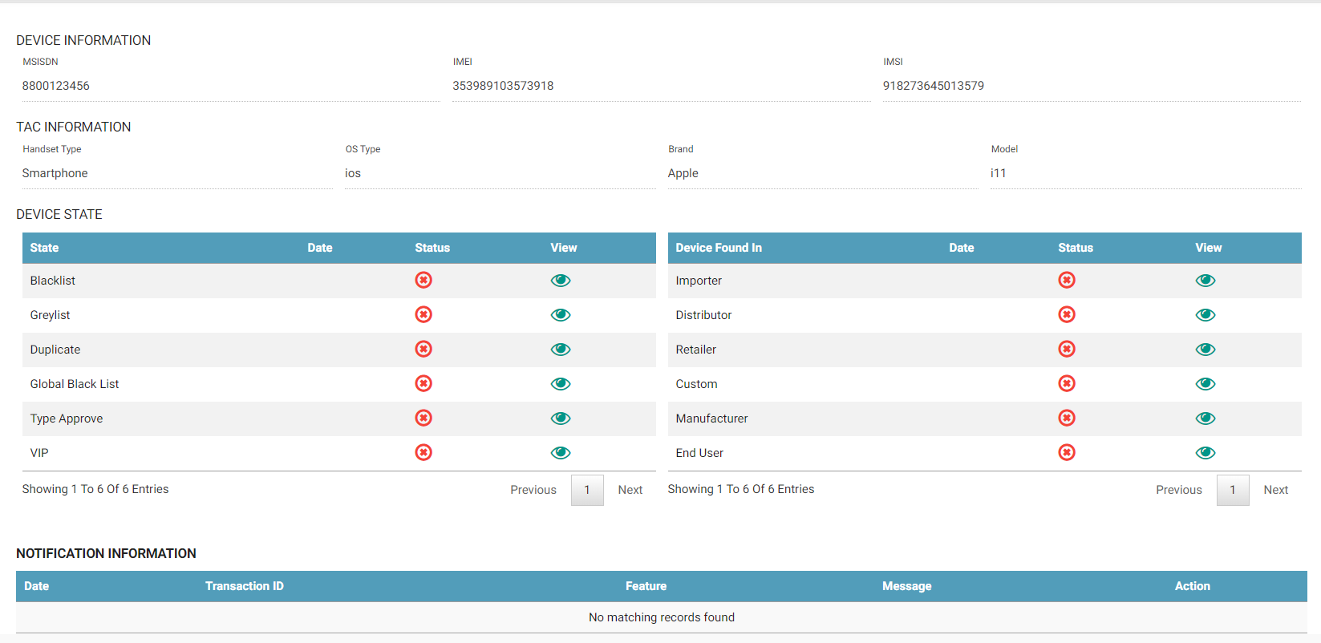
Search

Slide 9
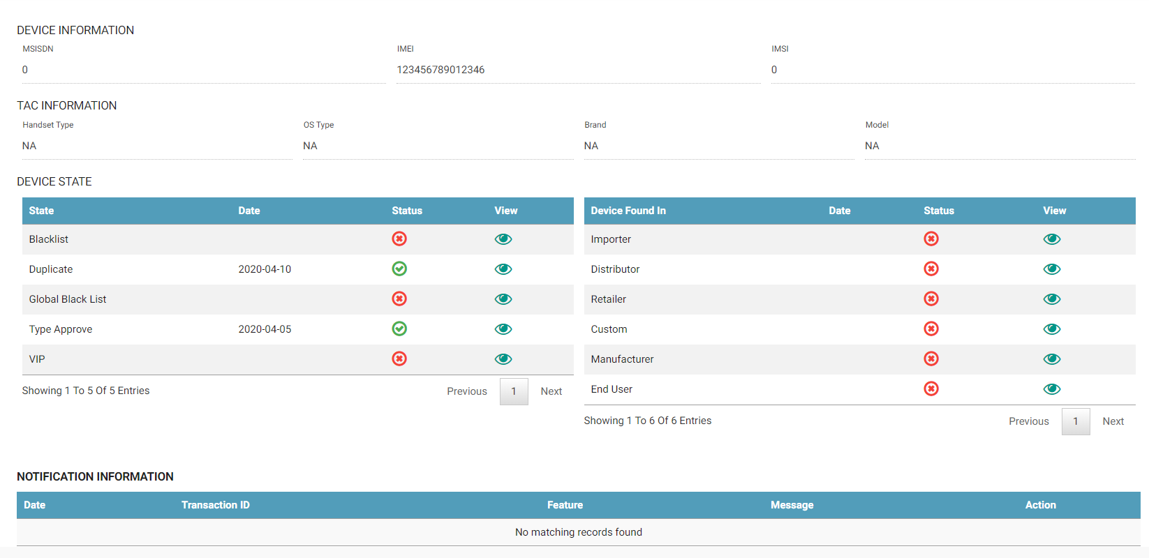
Search (Contd..)

Slide 10
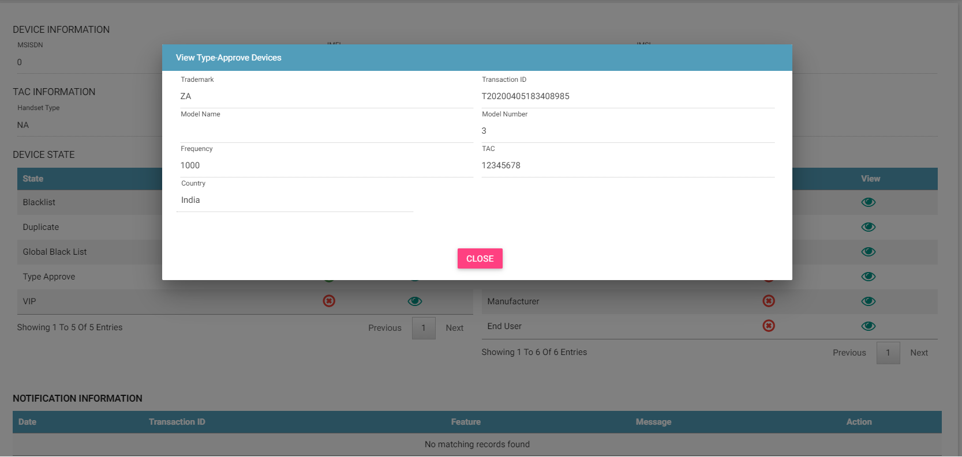
Search (Contd..)

Slide 11
IMEI – Reference in CEIR System
IMEI is present at multiple databases in the system
IMEI is present in
Importer Database
Distributor Database
Retailer Database
Custom Database (Tax Paid Database)
Manufacturer Database
IMEI may be present in
Grey List or Black List
Global Black List (GSMA)
IMEI may be active in network and hence assigned to MSISDN/IMSI
TAC part of IMEI is present in
GSMA Approved TAC List
TRC Approved TAC List
IMEI may be uploaded in the system by end user
Foreigner
VIP User
Cambodian User

Slide 12
CC – Information
A tick or cross flag is shown depending on whether the information is present in the respective DB or not
If the information is present, then the user can view further details by clicking on the eye icon
Also, all the SMS notification sent to the user would be shown here.

Slide 13
Search Scenarios - Stakeholder
Stakeholder Scenarios
Stakeholder is facing problem with feature or registration and not able to use the functionality
Ideally stakeholder should be redirected to raise grievance from the DMC home portal or using Grievance Management in their respective logins.
This will ensure low cost and CC agent is a very costly channel.
Stakeholder
Pre – Registration
User ID will not be there
OTP not coming
Post Registration
User ID will be there.

Slide 14
Search Scenarios - Stakeholder
User is complaining about some feature or error messages
I am not able to understand why error is coming.
In this case, they should redirected to the user manual/ self help guide or raise grievance

Slide 15
Search Scenarios - Stakeholder
User is complaining about some feature or error messages
I am not able to understand why error is coming.
In this case, they should redirected to the user manual/ self help guide or raise grievance

Slide 16
Search Scenarios – End user
End user is facing problem with feature (register device, visa update)and not able to use the functionality – User will be asked to enter the IMEI
End user has received a message to regularize the device. – User will be asked to enter MSISDN/IMEI/ or both

Slide 17
Grievance Management
Customer care can raise the grievance on behalf of other users. The other users are external users and end user.
Customer care will ask for the user ID of the user that is assigned to user at the time of registration
If user ID is found, then the system find the details and raise the grievance for that user.
If user ID is not found, i.e. user is not registered, the user details are also captured while raising the grievance.
Once the grievance is raised, the registered user can view the grievance once they log into the system
For unregistered user, the email would be sent to the user along with the grievance ID. The end user can see the grievance details based on grievance ID.

Slide 18
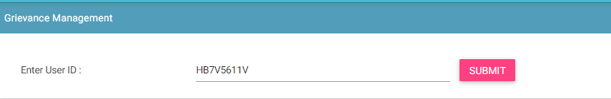
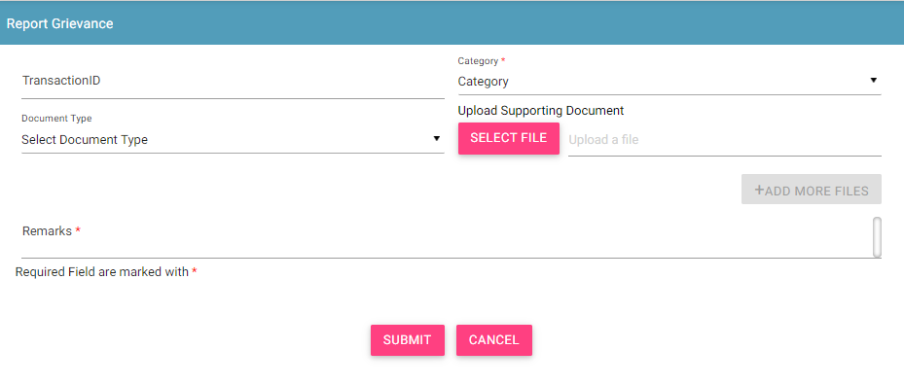
Grievance Management
For user who is already registered with CEIR system
Step 1:
Step 2:

Slide 19
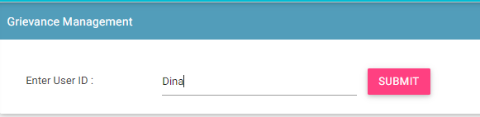
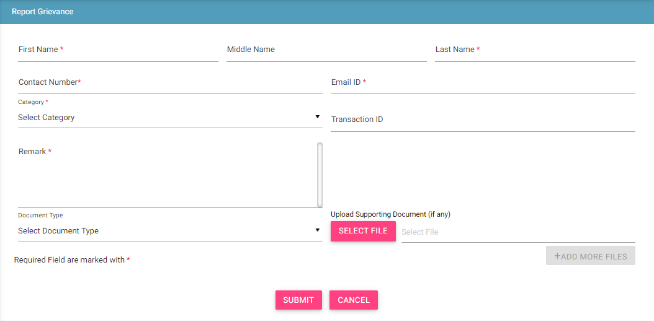
Grievance Management
For non-registered users
Step 1:
Step 2:

Slide 20
Impact
This user and feature is required to resolve any queries as raised by end user and stakeholder

Slide 21
Queries

Slide 22
Thank You

